Slide 1





a
NWS Hazard Simplification Project:
Plain Language Coming to NWS’
Watch, Warning, and Advisory System
Danielle Nagele, Senior Project Advisor
Website: https://www.weather.gov/hazardsimplification/
Contact Information: hazsimp@noaa.gov

Slide 2
The NWS “Watch, Warning and Advisory” System
How We Message for Weather & Water Hazards Today
Watch: Issued when a life- and/or property-threatening event is possible - but not yet certain
Warning: Issued when a life- and/or property-threatening event is happening or about to happen
Advisory: Issued when an event less serious than a Warning is happening or about to happen
Special Weather Statement: Issued when an event less serious (or of shorter duration) than an Advisory is happening or about to happen

Slide 3
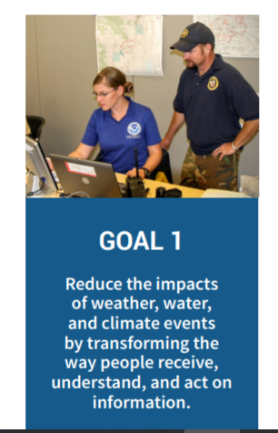

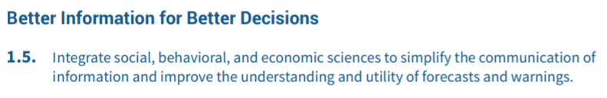
Hazard Simplification - The Opportunity
The Weather Act, Section 406
NWS
Strategic Plan
“The purpose of (NOAA’s) system for issuing
watches and warnings…shall be risk communication to the general public that informs action to prevent loss of life and property.”
“…(NOAA) shall assess the (NOAA) system for issuing watches and warnings regarding hazardous weather and water events…

Slide 4
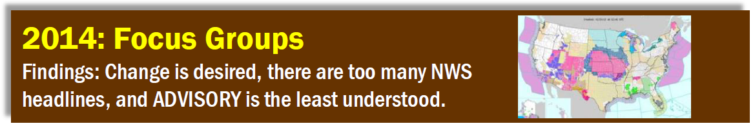

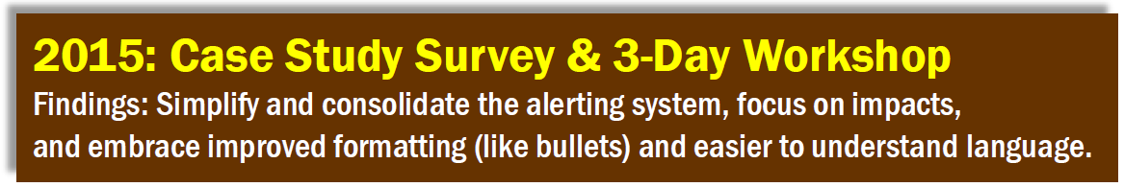
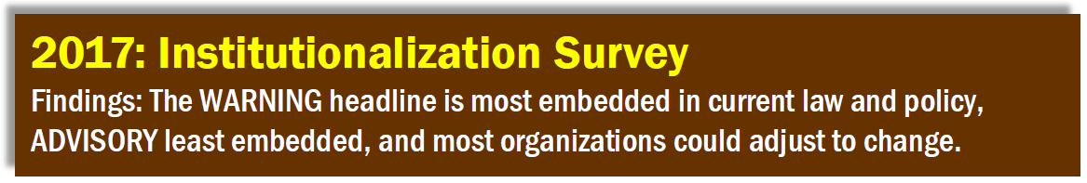
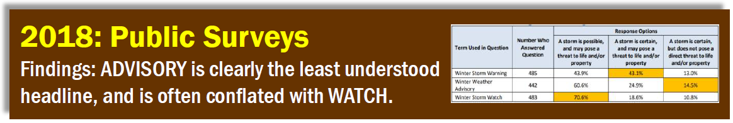
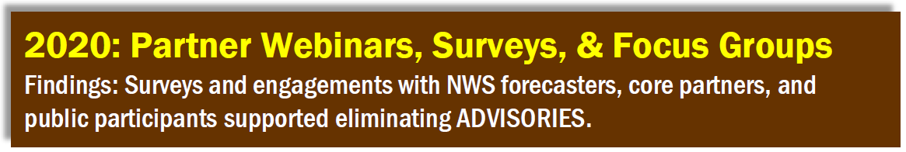
The Road to Simplification

Slide 5
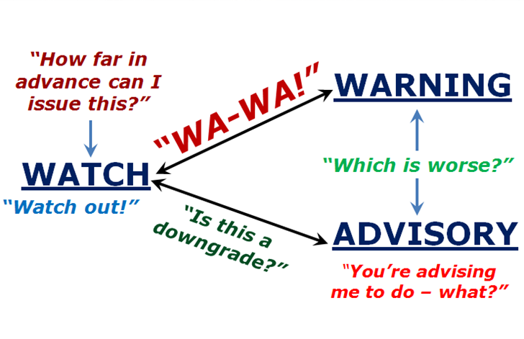
Why Transition to Plain Language?
Too many headline terms requires interpretation:
Instead just describe hazard and impact in plain language:
Emergency Managers prefer plain language headlines - they can be conveyed quickly and align with their need to copy and paste
Survey results from 2020 engagements with NWS partners and the public indicated strong support for plain language as well

Slide 6








What is the Major Change?
What should I do? - Prepare!
What should I do? - Take action!
WATCH
WARNING
What Will Remain
the Same?
What Will Change?
PLAIN LANGUAGE HEADLINES
An event less serious than a Warning is happening
What should I do? - Exercise caution to avoid impacts.
ADVISORY
&
SPECIAL WEATHER STATEMENT
Become

Slide 7
Replacing Advisories & Special Weather Statements
Plain Language Headline Options
NWS is currently considering three format options for the new plain language headline:
Option 1: Hazard leads message followed by description
Examples… “Snow: Light accumulations today” or “Snow: Slippery roads today”
Option 2: Caution leads message followed by hazard
Examples… "Caution: Light snow accumulations today" or "Caution: Snow with slippery roads today"
Option 3: Free text is used to describe hazard
Examples… "Light snow accumulations today" or "Snow with slippery roads today"

Slide 8
Transition to Plain Language Headlines
Examples of Fully Formatted Messages
Winter Weather Advisory transition to…. Plain Language Format
/O.NEW.KBMX.WW.Y.0001.200208T1000Z-200208T1700Z/
Cherokee-
Including the city of Centre
815 PM CST Fri Feb 7 2020
...WINTER WEATHER ADVISORY IN EFFECT FROM 4 AM TO 11 AM CST SATURDAY...
* WHAT...Snow expected. Total snow accumulations of up to one inch.
* WHERE...Northern Cherokee County.
* WHEN...From 4 AM to 11 AM CST Saturday.
* IMPACTS...Plan on slippery road conditions.
/O.NEW.KBMX.WW.S.0001.200208T1000Z-200208T1700Z/
Cherokee-
Including the city of Centre
815 PM CST Fri Feb 7 2020
* WHAT...Snow expected. Total snow accumulations of up to one inch.
* WHERE...Northern Cherokee County.
* WHEN...From 4 AM to 11 AM CST Saturday.
* IMPACTS...Plan on slippery road conditions.
0
VTEC
Plain language headline - Specific wording TBD
Bullet format
Special Weather Statement transition to… Plain Language Format
North Snowy Range Foothills-
Including the cities of Arlington and Elk Mountain
1143 PM MDT Mon Sep 23 2019
...Strong westerly winds until this evening...
Strong westerly winds will pick up this morning by 7 AM and
continue through the day, finally diminishing by 6 PM. Sustained winds around 30 mph with gusts of 45 to 50 mph are possible.
/O.NEW.KCYS.WI.S.0001.190923T0543Z-190923T0000Z/
North Snowy Range Foothills-
Including the cities of Arlington and Elk Mountain
1143 PM MDT Mon Sep 23 2019
* WHAT...Sustained winds of 30 mph with gusts of 45 to 50 mph.
* WHERE...North Snowy Range Foothills.
* WHEN...Tuesday 7 AM to 6 PM.
* IMPACTS...Light weight and high profile vehicles will be most impacted.
Now with VTEC!
Plain language headline - Specific wording TBD
Now with “3W” bullets!

Slide 9
List of Advisories to be Transitioned
Winter Weather Advisory | Lake Wind Advisory | Air Stagnation Advisory | High Surf Advisory
Wind Chill Advisory | Frost Advisory | El Nino/La Nina Advisory | Small Craft Advisory - transition to “Warning”
Dense Fog Advisory | Blowing Dust Advisory | Tsunami Advisory - may transition to “Warning” | Lakeshore Flood Advisory
Dense Smoke Advisory | Dust Advisory | Freezing Spray Advisory | Coastal Flood Advisory
Wind Advisory | Ashfall Advisory | Low Water Advisory | Flood Advisory (Areal)
Heat Advisory | Freezing Fog Advisory | Brisk Wind Advisory | Flood Advisory (River)

Slide 10
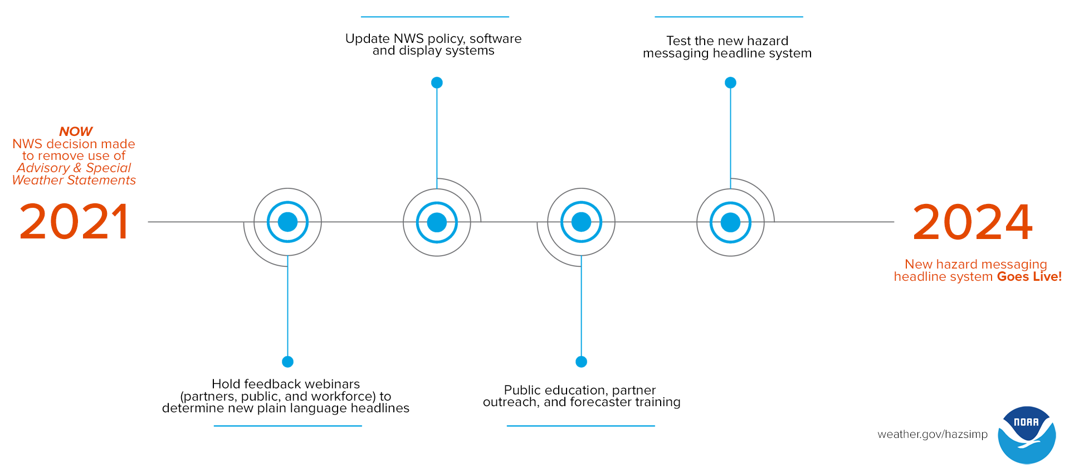
Summary
Revamp - Remove Advisory term from the system in favor of plain language headlines
Option 1: “Snow: Light accumulations today”
Option 2: “Caution: Light snow accumulations today”
Option 3: “Light snow accumulations today”
Repair
Consolidation: less product types
Reformatting: more clear, intuitive formats

